Slide 1

SDLC Part 1
Spring 2022

Slide 2
1.
SDLC
Software Development Life Cycle

Slide 3
SDLC Part 1
The cycle:
Planning and Requirement Analysis
Defining Requirements
Design Product Architecture
Developing the Product
Testing the Product
Deployment of the Product

Slide 4
Planning
Defining
Developing
Testing
Deployment
Designing

Slide 5
1. Planning and Requirement Analysis
Identify purpose and scope of the application
Identify stakeholders – anyone who stands to benefit from this application
Calculate and research costs, risks, structures, timelines, methods etc

Slide 6
2. Defining Requirements
Define what the application should do exactly
Define the specific requirements for the application to function
Define the risks associated with the requirements

Slide 7
3. Designing
Define the steps taken to achieve all the defined requirements
For our class, this will be documented in your production plan

Slide 8
4. Developing
Actual execution on the development of the application.
Stick to the agreed plan and programming guidelines.

Slide 9
5. Testing
Testing to determine if the developed application meets the defined requirements.

Slide 10
6. Deployment
Deploying the software into the target environment.

Slide 11
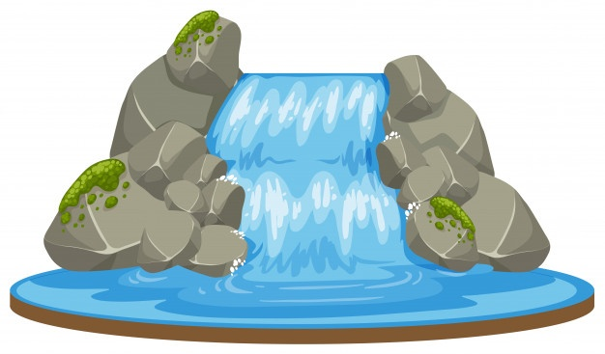
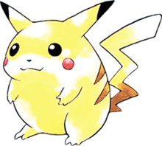
Common Models of SDLC
Waterfall
Agile

Slide 12
Waterfall
Each stage done to completion before moving on
Easy to understand
Very clear on requirements
Tough to accommodate changes midway
Notes:
Examples
Creating production lines, adding to existing processes

Slide 13
Agile
Iterative and incremental
Working software is built and delivered each iteration
Adapts to changes well
Greater risks for long factors :
Sustainability
Maintainability
Extensibility

Slide 14
A bit of both
Long term plan for product
Milestones
Product direction
Plan accommodates changes
New requirements based on user feedback
Other challenges

Slide 15
First 2 Stages – Plan and Define
Focus for today

Slide 16
Stage 1 : Planning

Slide 17
Planning and Requirement Analysis
Identify purpose and scope of the application
Identify stakeholders – anyone who stands to benefit from this application
Calculate and research costs, risks, structures, timelines, methods etc

Slide 18
Stage 1 : Planning
Value
Target
How

Slide 19
Value
What problem are you trying to solve?
What is your unique selling point?
What is the scope of your proposal?

Slide 20
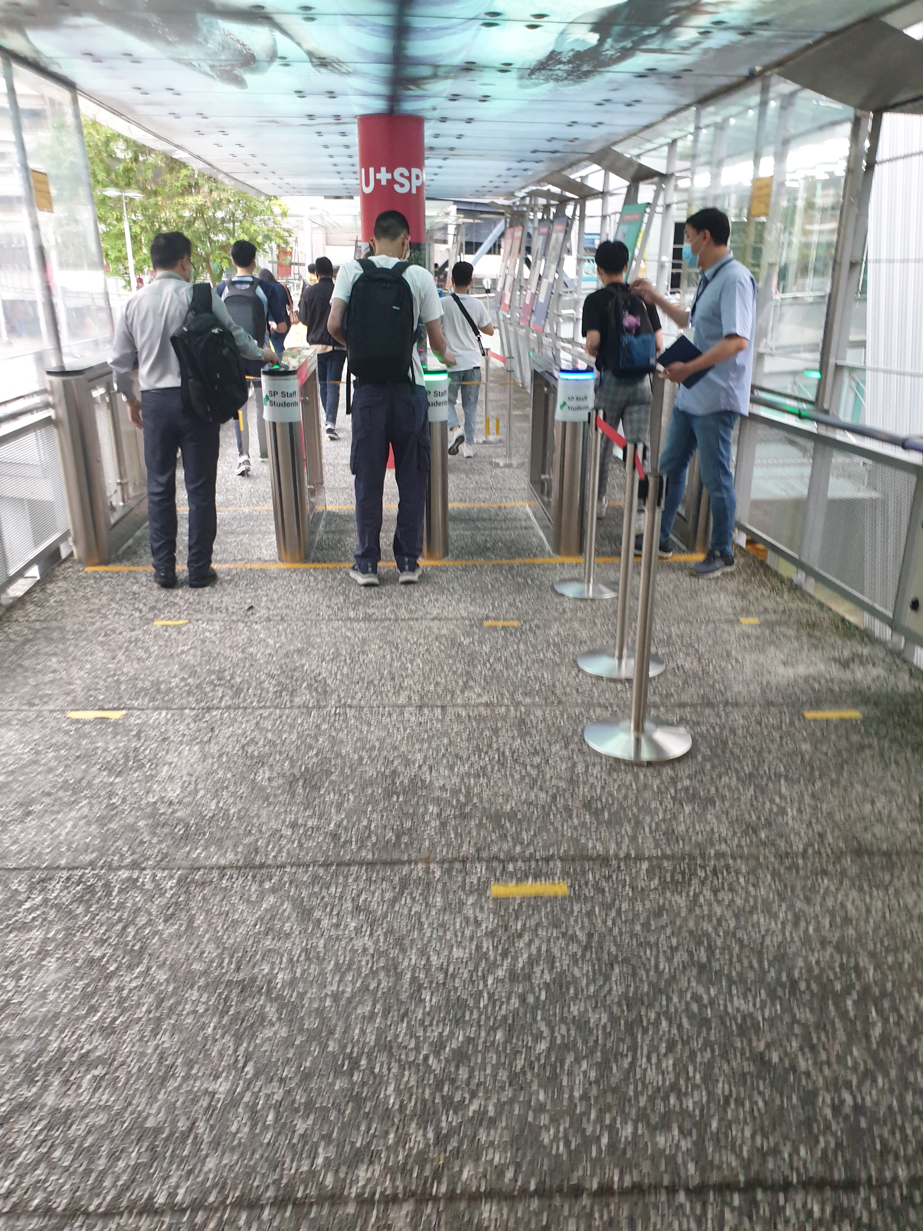
Notes:
What problem are you trying to solve?
What is your unique selling point?
What is the scope of your proposal?

Slide 21
First Principles Thinking
Identify and define current assumptions
Breakdown problem to fundamental principles
Build solution from scratch

Slide 22
Target
Who does this product benefit?
How does this product benefit them?
What is the market for this product?

Slide 23

Story Time

Slide 24
Market Opportunities
There might be a hole in the market, but is there a market in the hole?
Do your research

Slide 25
Common Business Transactions
Business to Business (B2B)
Business to Consumer (B2C)
Business to Government (B2G)

Slide 26
Business to Business (B2B)
Between one business and another (ok….)
Tends to happen in a supply chain
For games, business done with publisher and/or platform
Notes:
For games, business done with publisher or platform

Slide 27
Business to Consumer (B2C)
Goods and services of the business are provided directly to the consumer
The consumer are the users of the goods and services

Slide 28
Business to Government (B2G)
Government contracts.
Typically the government would request for proposals
Companies would then bid for contracts

Slide 29

In Singapore

Slide 30
How
What do you need to make this happen?
Time
Money
Hardware
Software
etc

Slide 31
Stage 2 : Defining

Slide 32
Defining Requirements
Define what the application should do exactly
Define the specific requirements for the application to function
Define the risks associated with the requirements

Slide 33
Functional Requirements
Define basic system behaviour
What the system should or should not do
Features required for system to function as intended

Slide 34
Non-Functional Requirements
User experience and usability
Safety , ethics, security
Reliability, performance, scalability

Slide 35
Case Studies

Slide 36
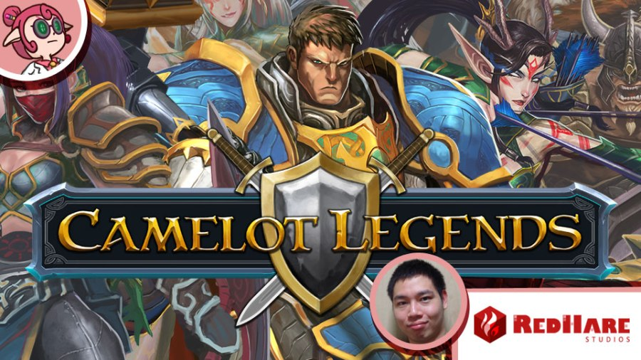

Slide 37
Camelot Legends
IOS
Turn-based RPG
Done in C++ using Cocos2DX
B2C - Premium business model

Slide 38
Camelot Legends - Planning
Value – Using existing IP for a mobile experience
Target – Casual Gamers, initially with freemium model
How – Using C++, cocos2dx and cocos editor.

Slide 39
Camelot Legends - Defining
Timleine - 6 months of development with a
Team –
4 artists
4 client developers
3 backend developers
2 producers
Technology – C++, Cocos2DX, Cocos2D editor, Javascript, backend server(cannot remember which exactly)

Slide 40
Camelot Legends – Defining
Requirements
Turn based combat (JRPG style)
Unlockable characters
Weapon upgrade system
Character progression system
Paywalls
Microtransaction support
Support for added content and events
Enforcing company specific user accounts

Slide 41
Camelot Legends – What happened
Game concept changed 4 times over 1.5 years to chase market trends
This project was a partnership with another company, with support of a government grant
Other company decided not to finish the project.

Slide 42
Camelot Legends – What happened
Game then became a standalone client game on the IOS
Converted to Premium model
Government claimed back funding for final milestone as penalty for late completion

Slide 43
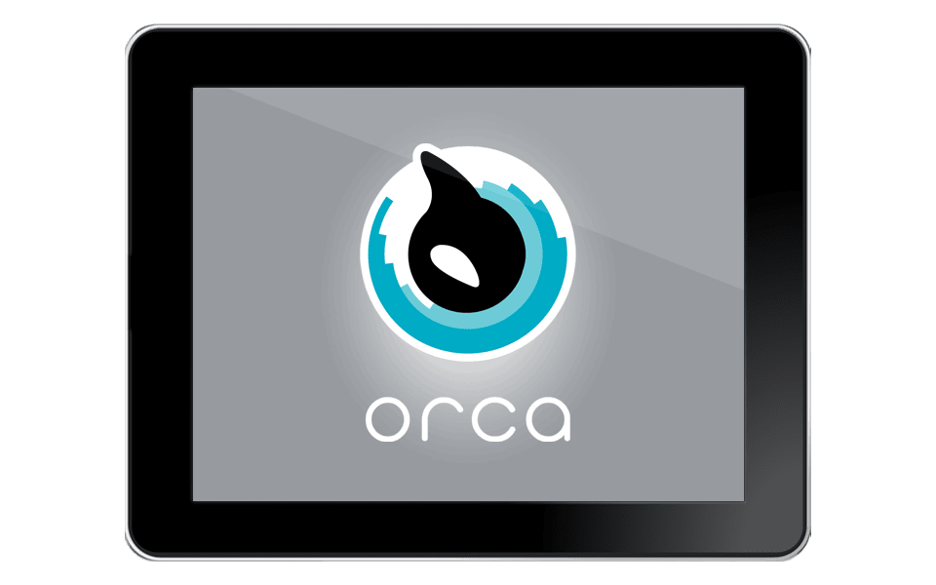

Slide 44
ORCA BOS
Business Operating System, an F&B and Retail solution
IOS client, Wildfly server and MongoDB backend
Done in Objective C and JavaScript
B2B, license subscription model

Slide 45
ORCA BOS - Planning
Value – Solution optimizes workflows and processes, provides complete tech ecosystem from front to back end.
Target – F&B operators, franchise owners, shopping mall owners
How – IOS App, backend server and database

Slide 46
ORCA BOS - Defining
Timleine – Recurring, service
Team –
1 artist
2 deployment specialist
7 Front/Back end developers
3 Business developers (also part of the programming team)
Technology – Apple tablets, Mac mini, Objective C, JavaScript, MongoDB

Slide 47
ORCA BOS – Defining
Requirements
Point of sales system
Ordering system
Kitchen Management System
Assembly station System
Backend reporting system
Stock ordering and management system
Customer reward management system
Adherence to tax laws of countries
Menus and offers need to be constantly updated
Long term service and support

Slide 48
ORCA BOS – What happened
Each F&B concept wanted features made to adapt to their way of doing things
F&B specialist business partner, started selling shares of phantom companies claiming phantom companies owned this IP

Slide 49
ORCA BOS – What happened
Same partner, main business plan was to earn through selling shares and selling the company and IP
Problem with recurring income, went 2 months without pay.

Slide 50
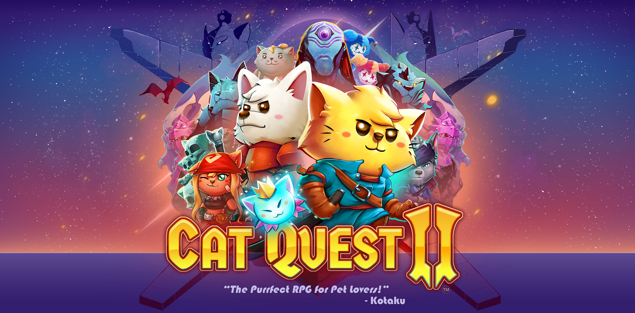

Slide 51
CAT QUEST 2
Casual game
Multiplatform
Done with Unity
B2C, premium business model

Slide 52
CAT QUEST 2 - Planning
Value – Cute catsual game with very low barrier of entry, with added content for at least a year after launch
Target – Most markets for all platforms
How – Unity for multiplatform development

Slide 53
CAT QUEST 2- Defining
Timleine – 2 year development, 1 year support
Team –
2 artists
2 programmers
Technology – Unity, extra Unity packages, dev kits for platforms, other tools for assets

Slide 54
CAT QUEST 2 – Defining
Requirements
Control scheme needs to cater for touch, keyboard mouse, and console controllers
Easy to use for all platforms
Must work on all platforms at consistent framerate
Must support local multiplayer
Must support single player with AI controlling 2nd character

Slide 55
CAT QUEST 2 – Defining
Extra costing
Audio Assets
Translations
Dev kits
3rd Party Libraries

Slide 56
CAT QUEST 2 – What happened
Mechanics and interfaces were iterated throughout development
Constant informal testing
Strict adherence to milestones
Successful launch

